Slide 1



National Public Heath Laboratory (Cameroon)
MEKA Moise Christian Junior
FOUDA MONEYANG Françoise Cely

Slide 2
Plan
Workflow
Samples collected
Sequencing results

Slide 3
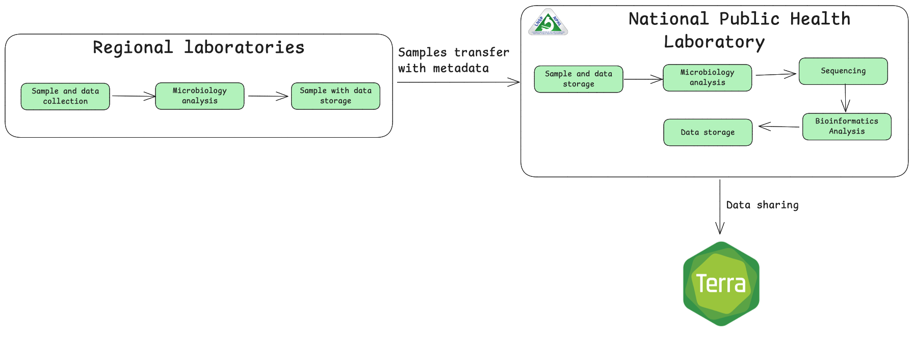
Workflow

Slide 4
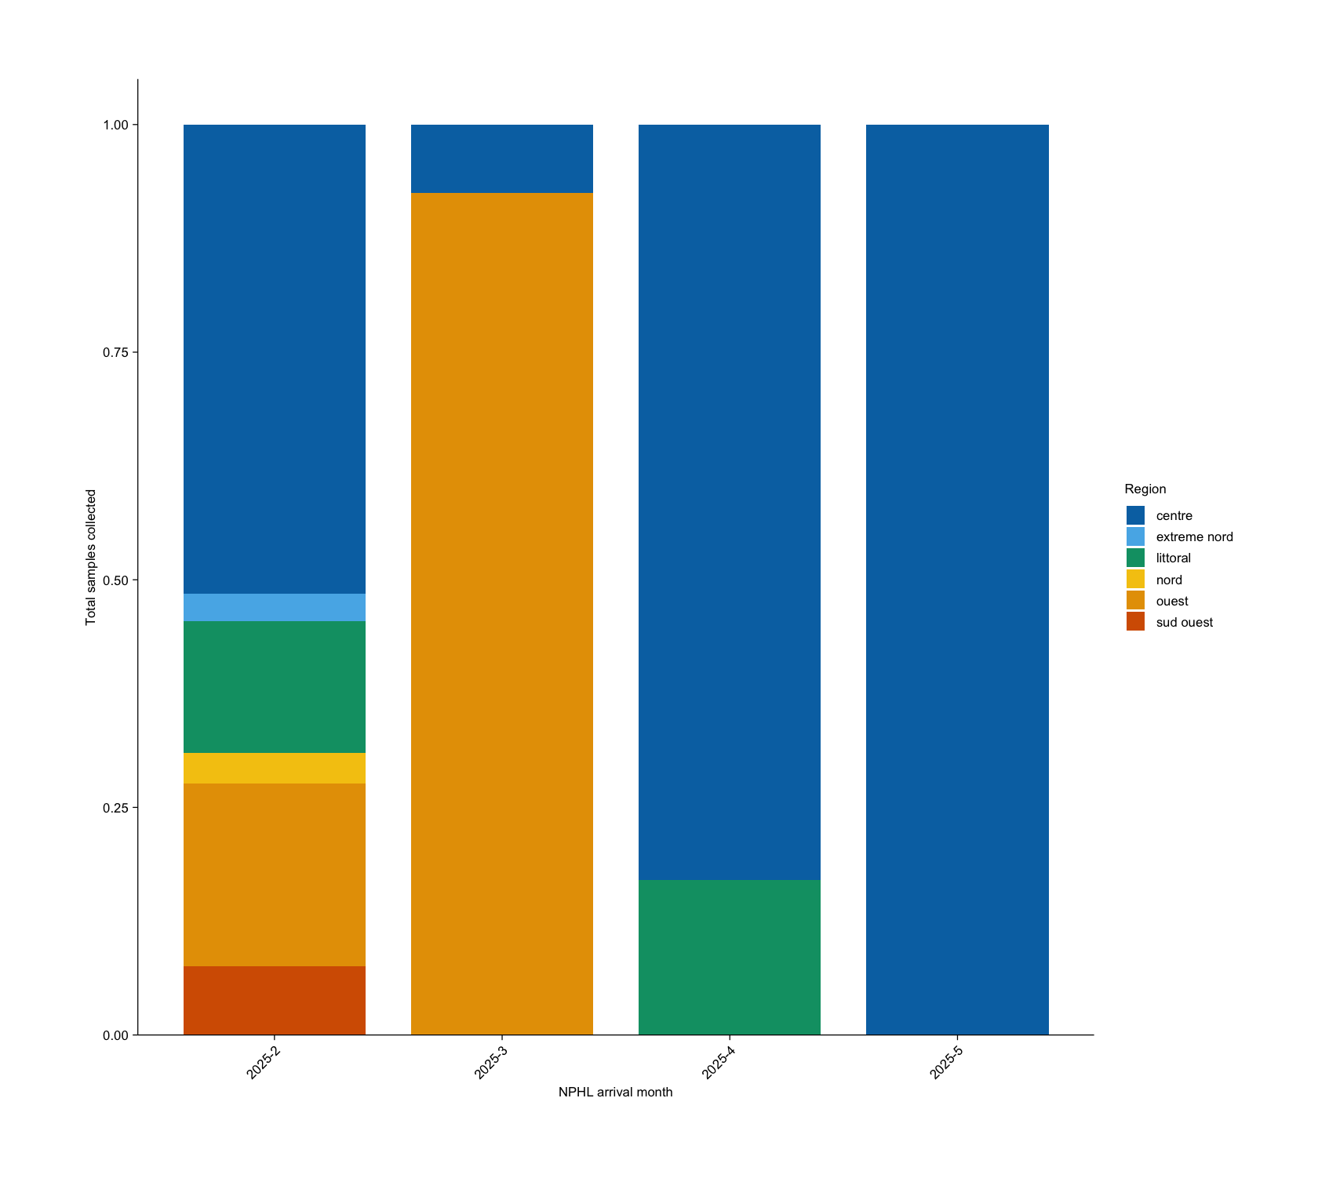
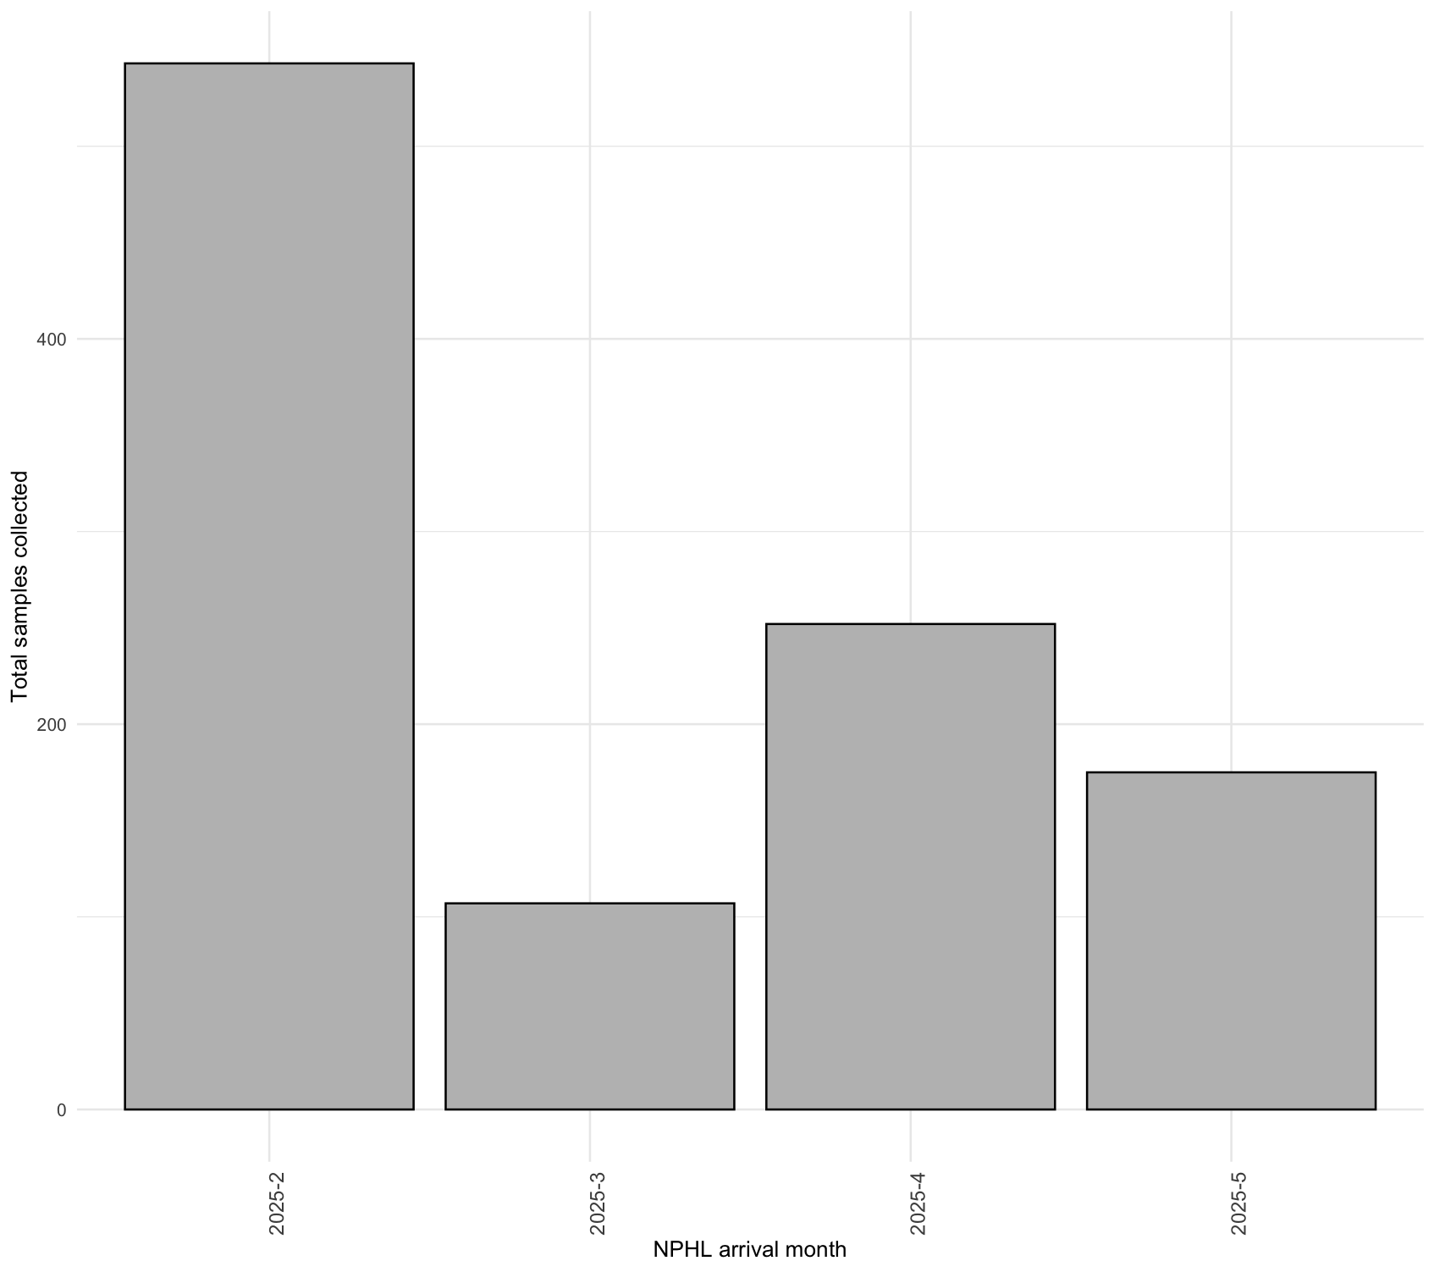
Samples collected (1/4)

Slide 5
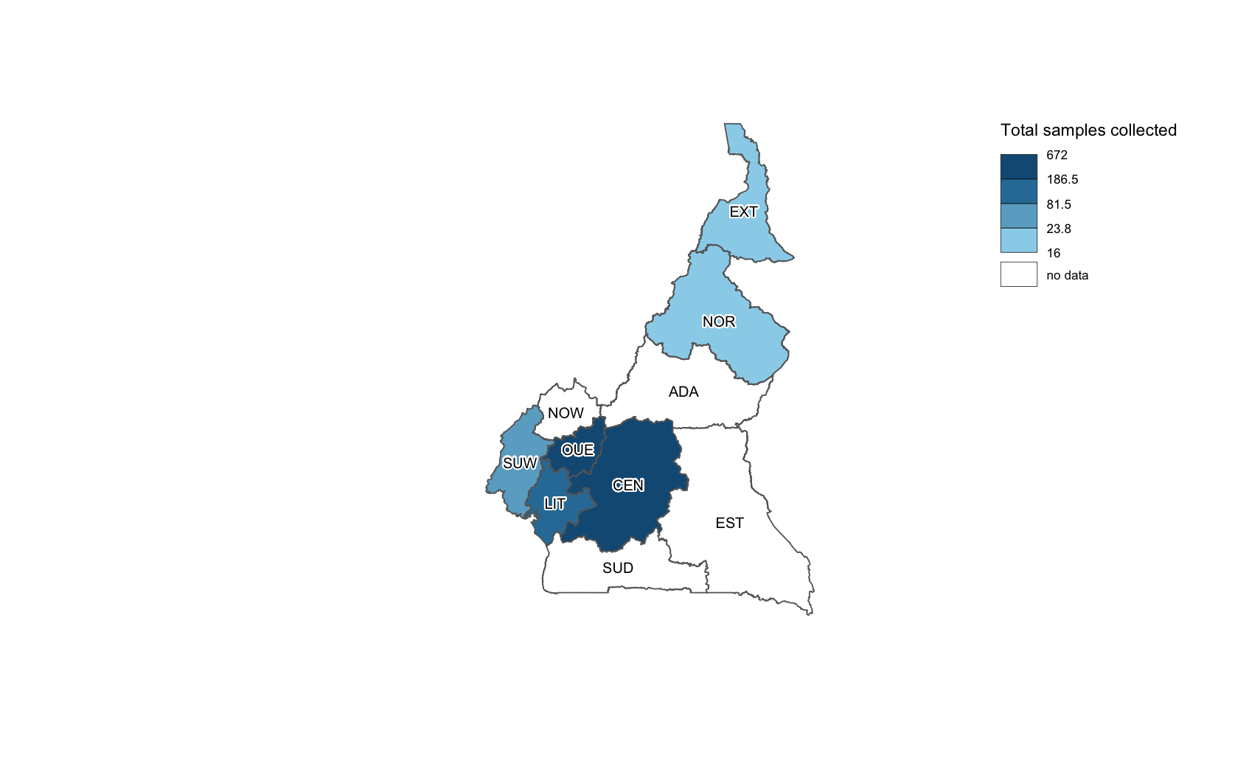
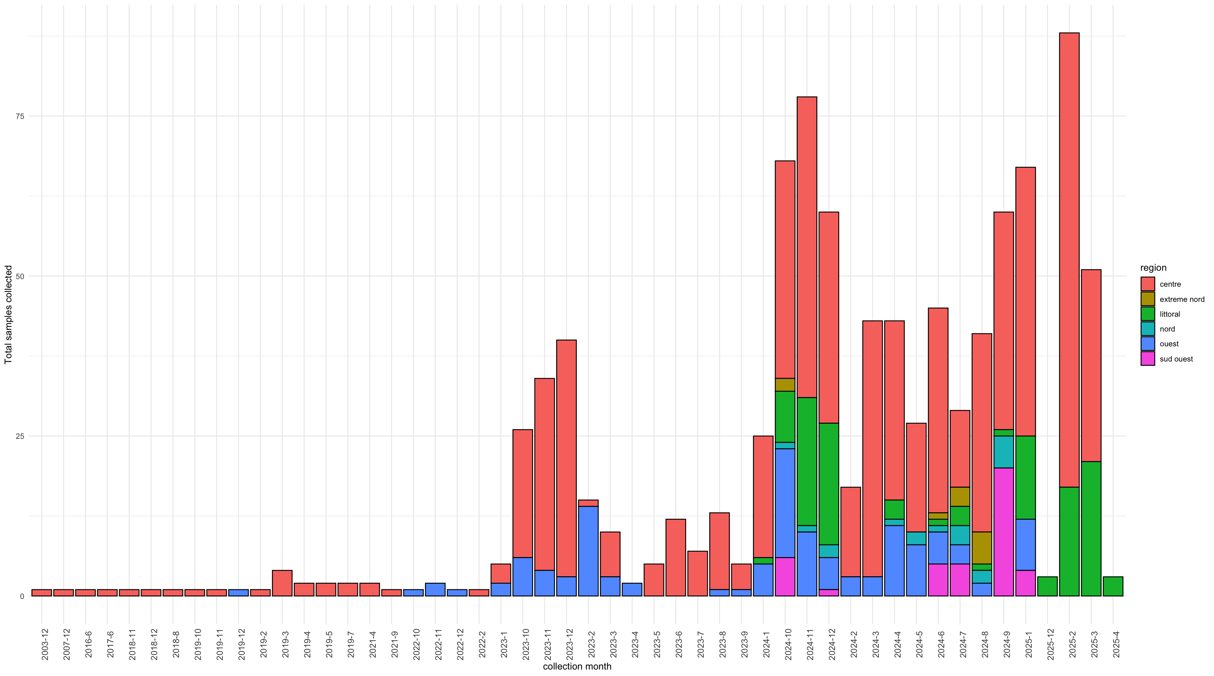
Samples collected (2/4)

Slide 6
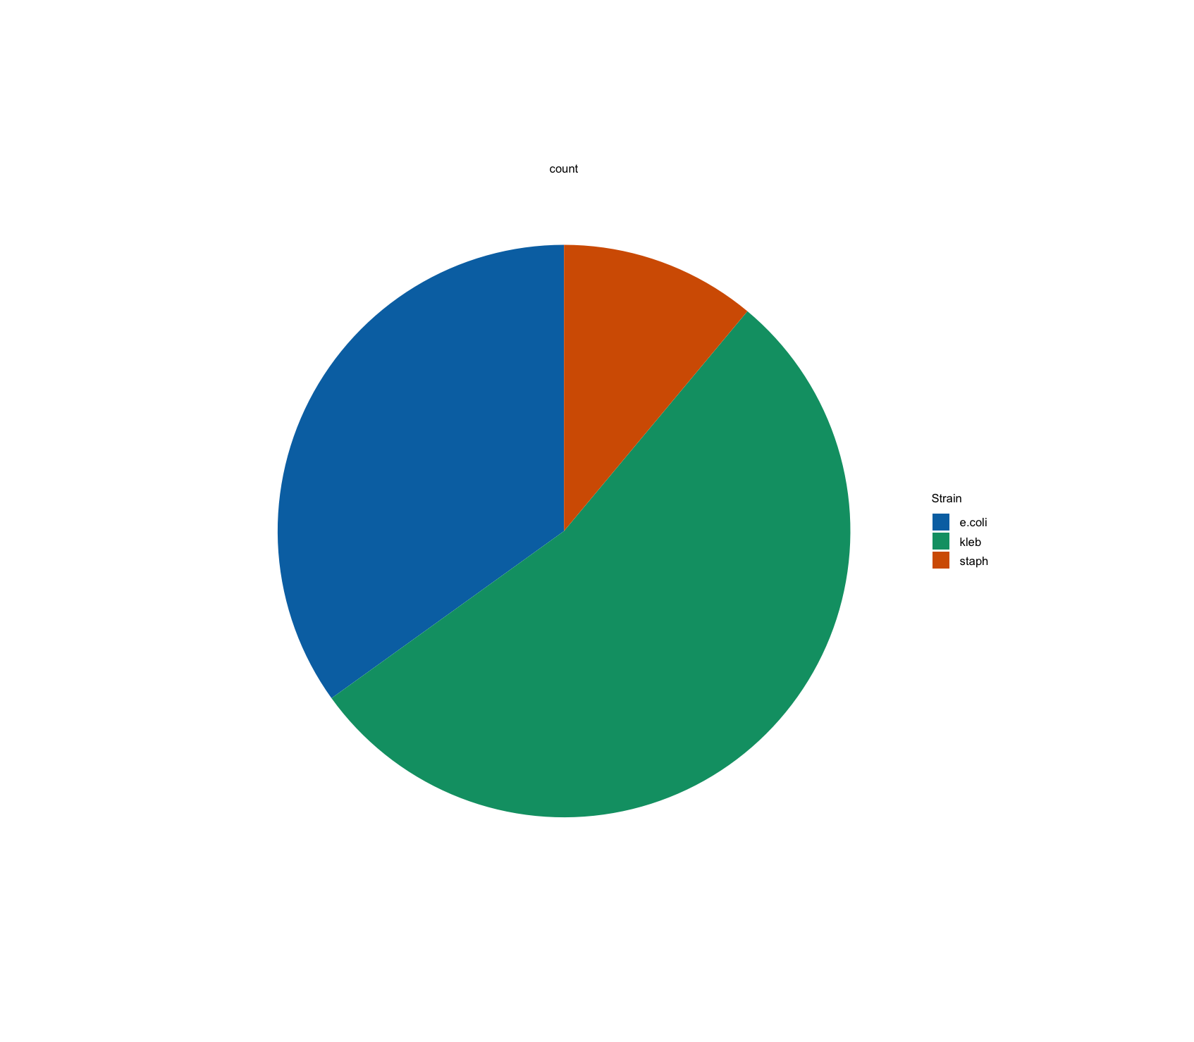
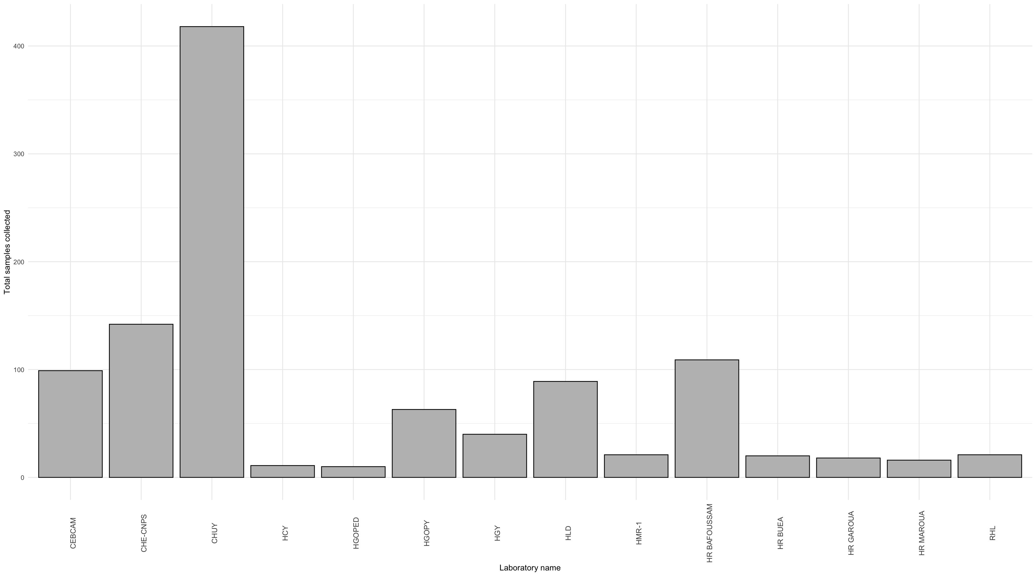
Samples collected (3/4)

Slide 7
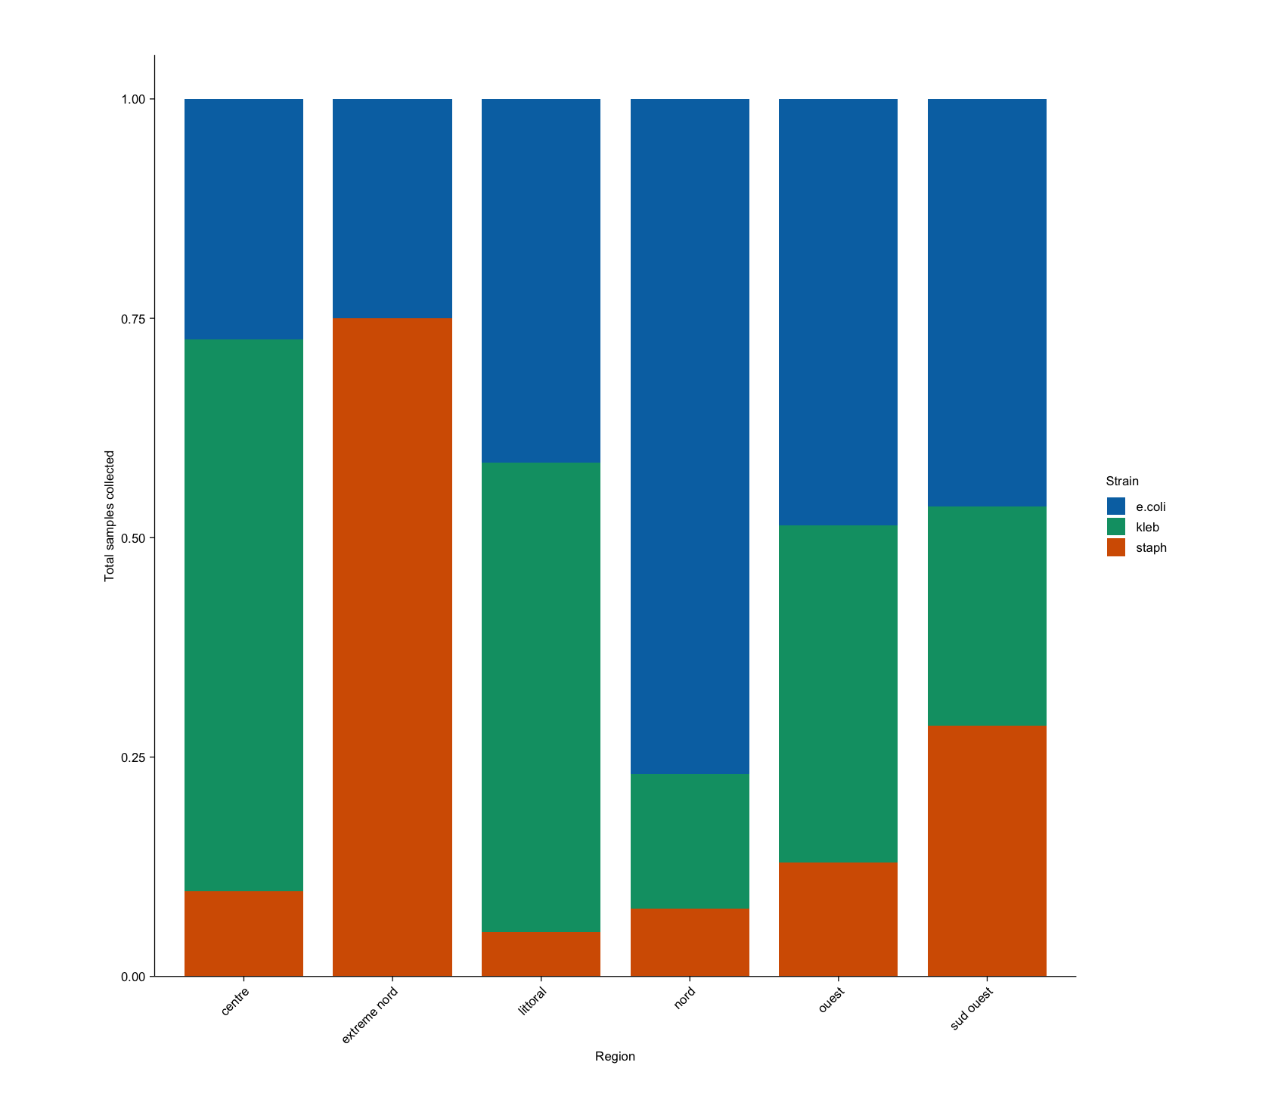
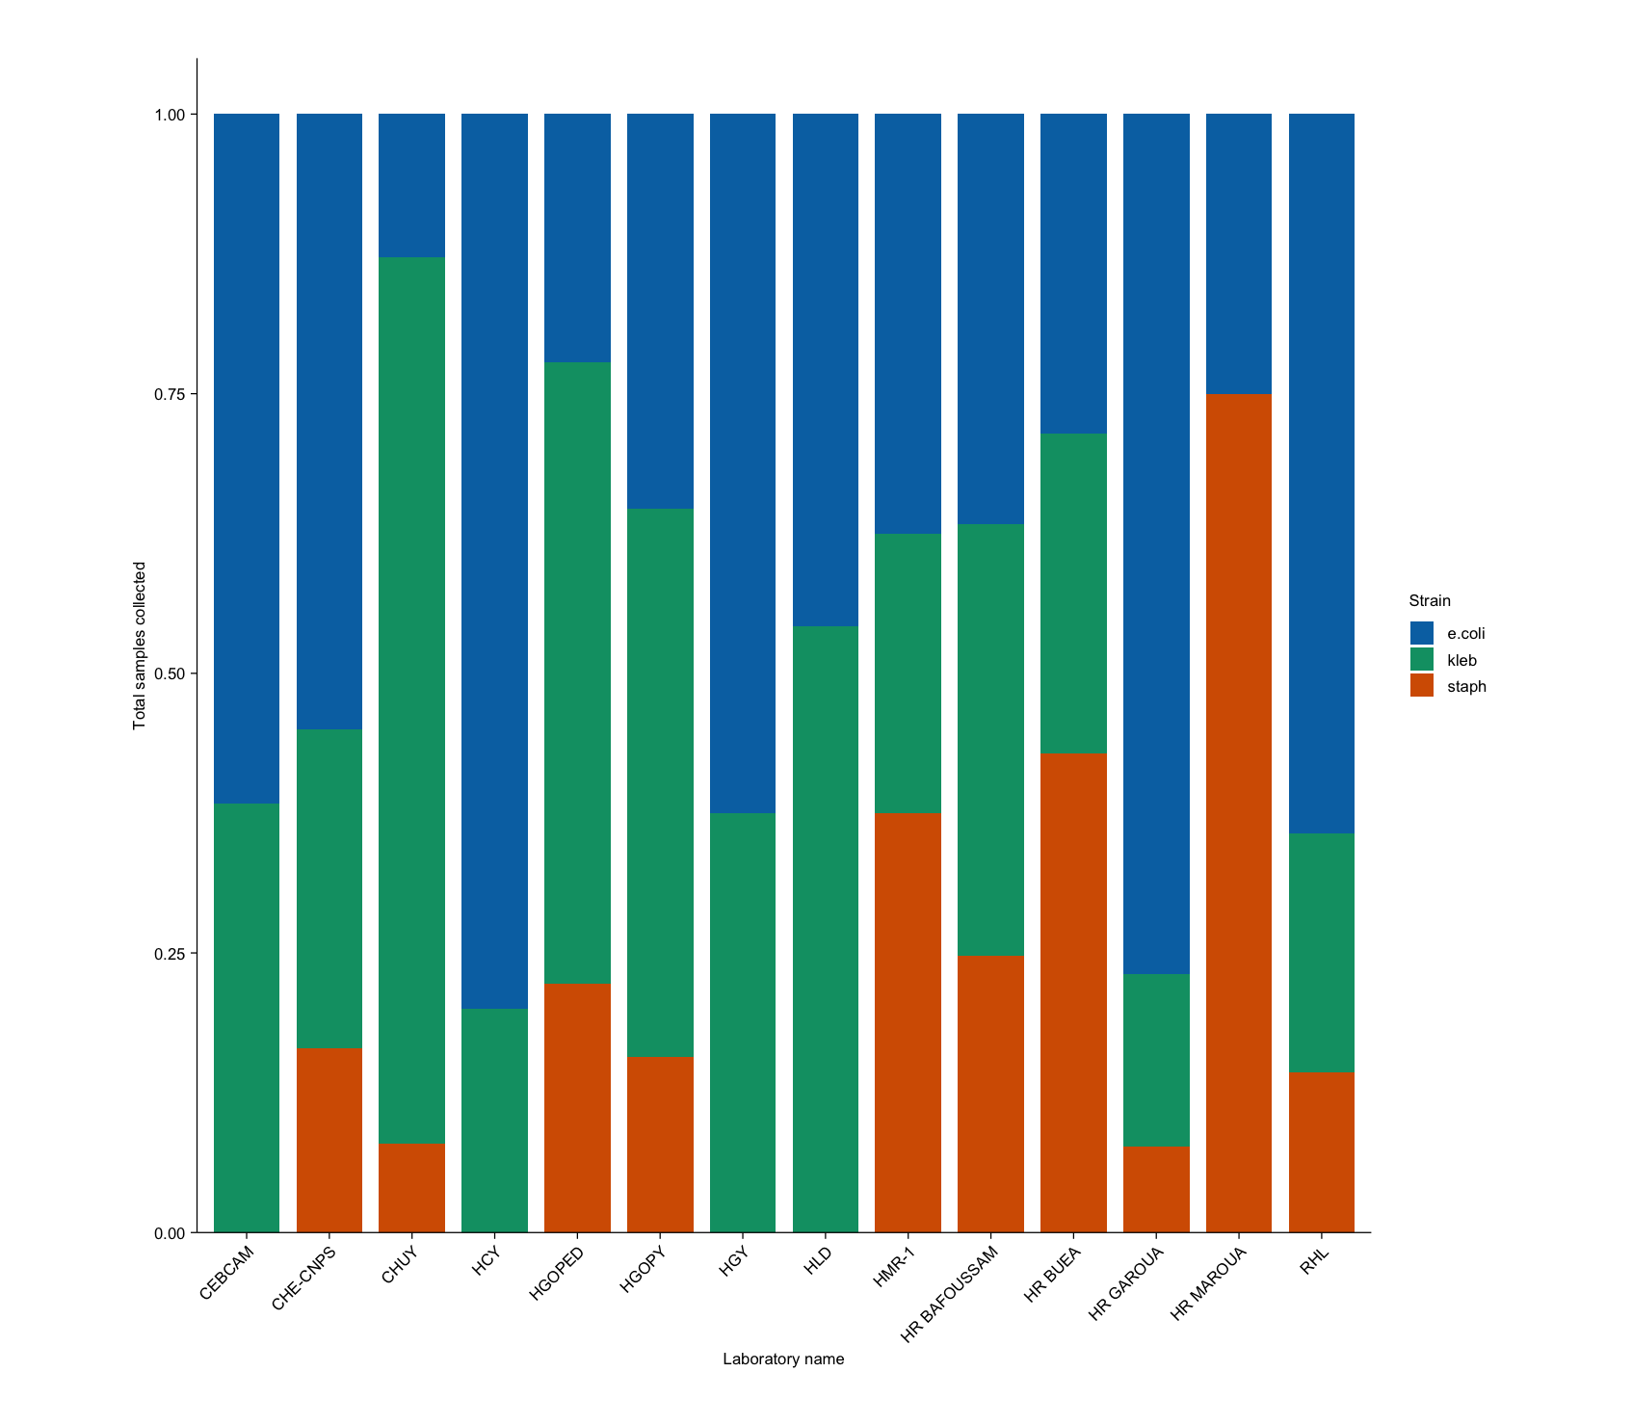
Samples collected (4/4)

Slide 8
Sequencing results (1/4)
 | Centre | Extrême Nord | Littoral | Nord | Ouest | Sud Ouest | Total
Escherichia coli | 74 | 1 | 18 | 9 | 6 | 8 | 116
Klebsiella Pneumoniae | 53 | 0 | 9 | 1 | 9 | 9 | 81
Klebsiella quasipneumoniae | 4 | 0 | 1 | 0 | 0 | 0 | 5
Klebsiella Variicola | 0 | 0 | 0 | 1 | 0 | 0 | 1
Total | 131 | 1 | 28 | 11 | 15 | 17 | 203

Slide 9
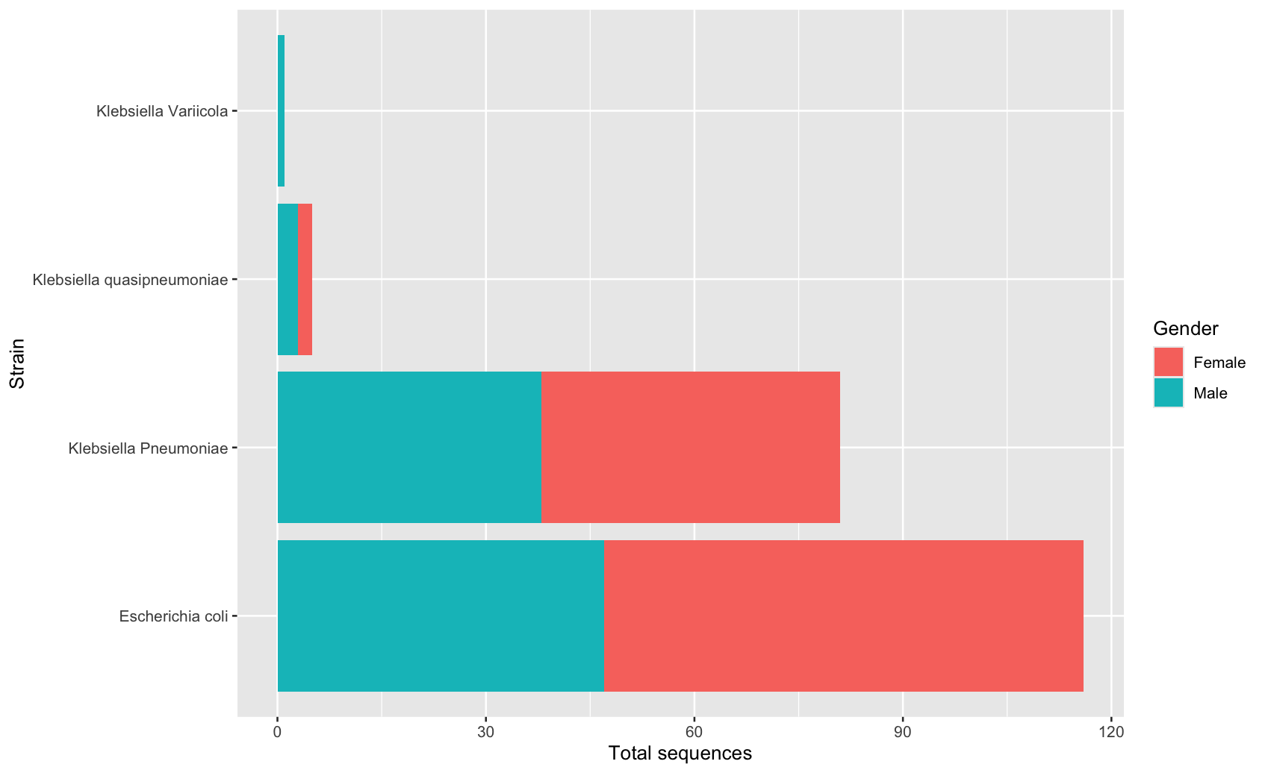
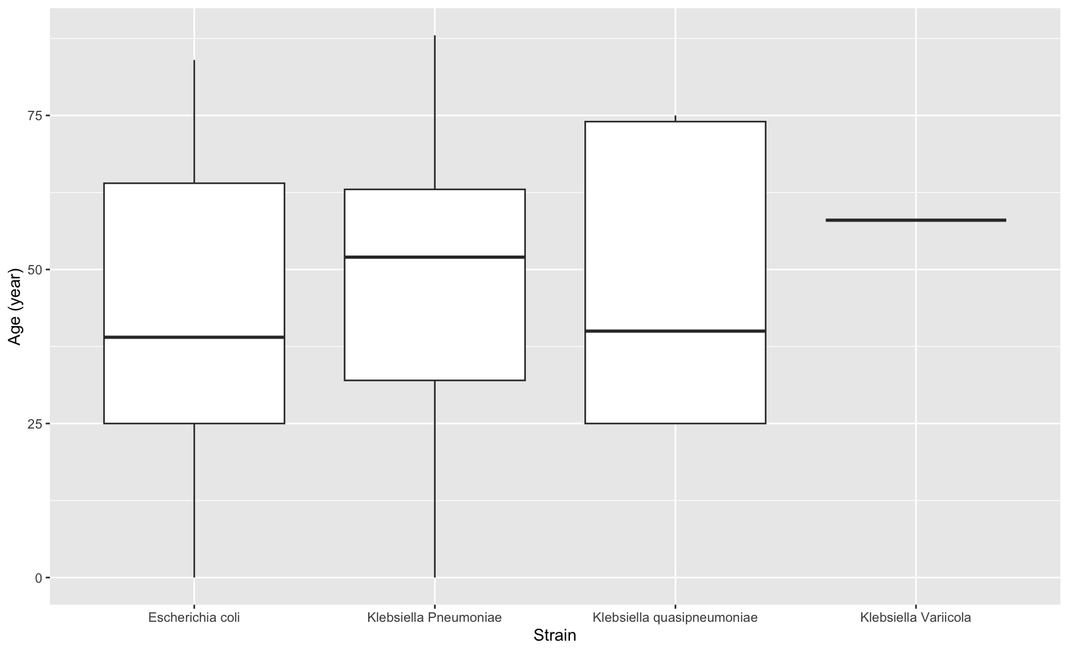
Sequencing results (2/4)

Slide 10
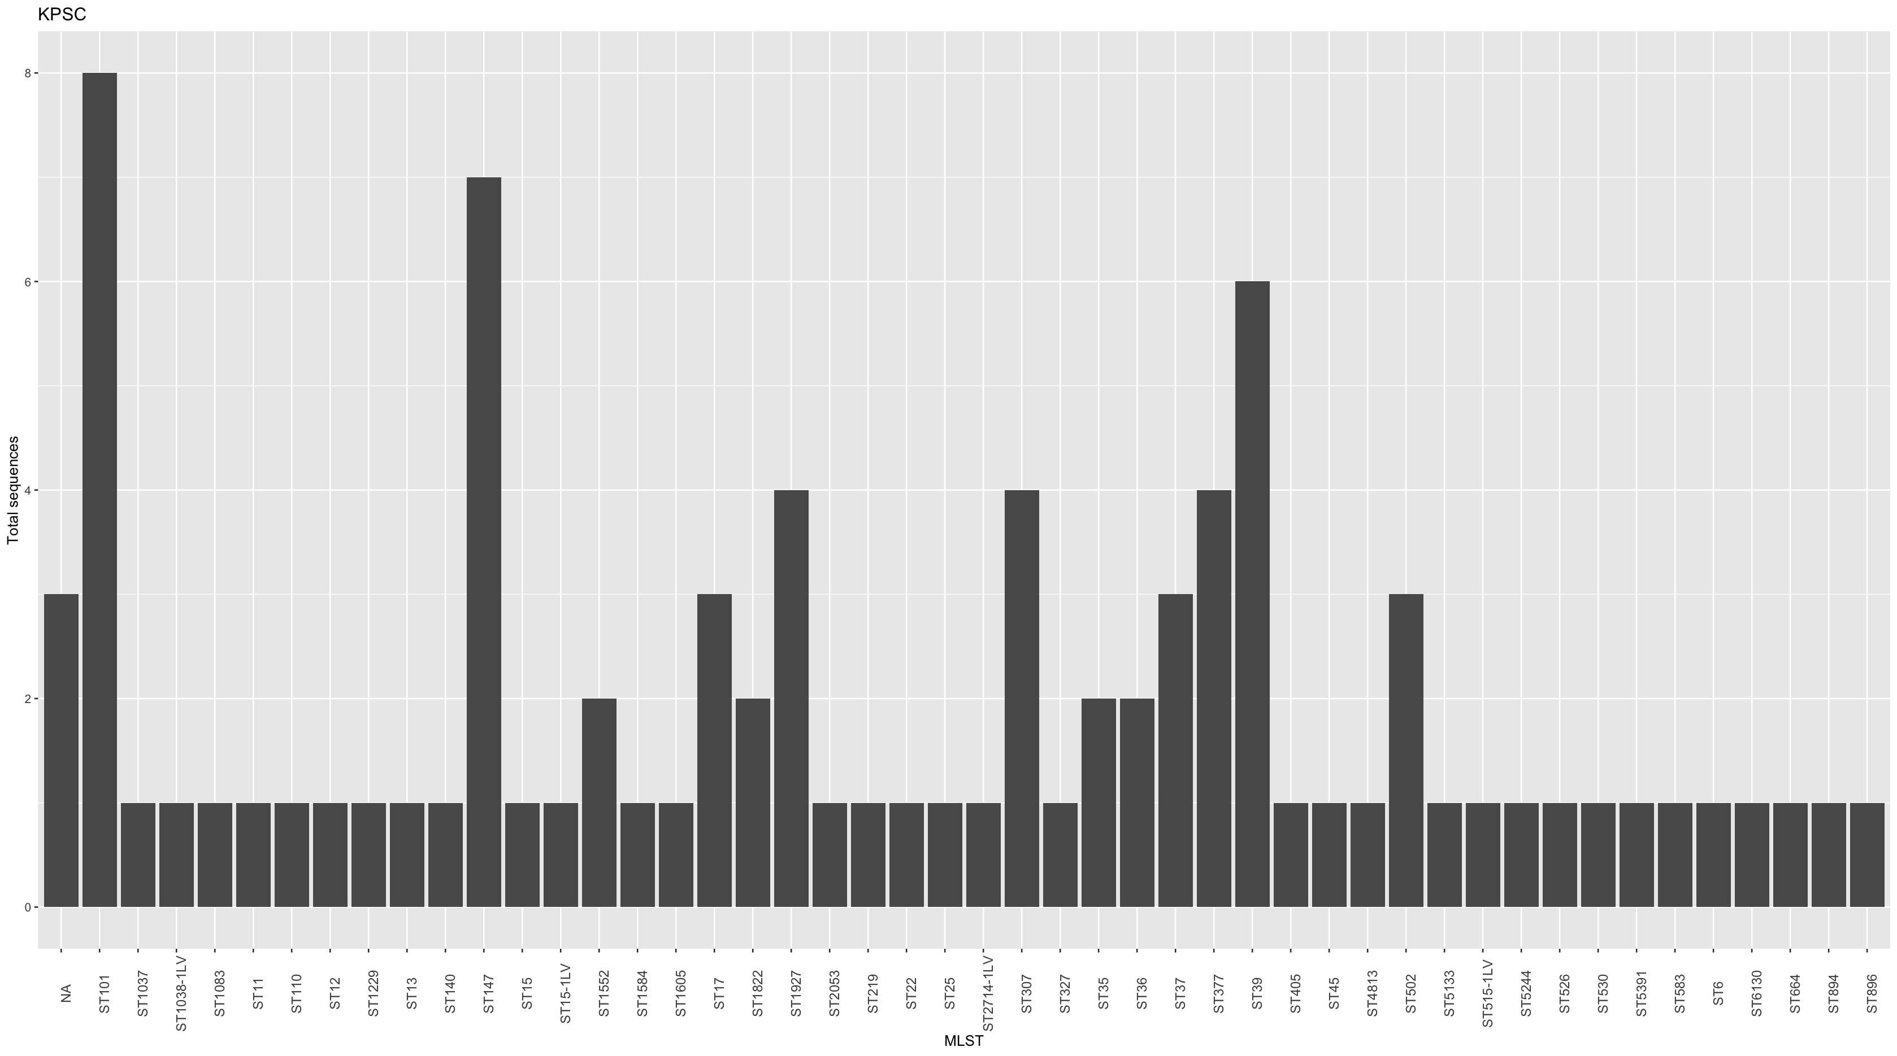
Sequencing results (3/4)

Slide 11
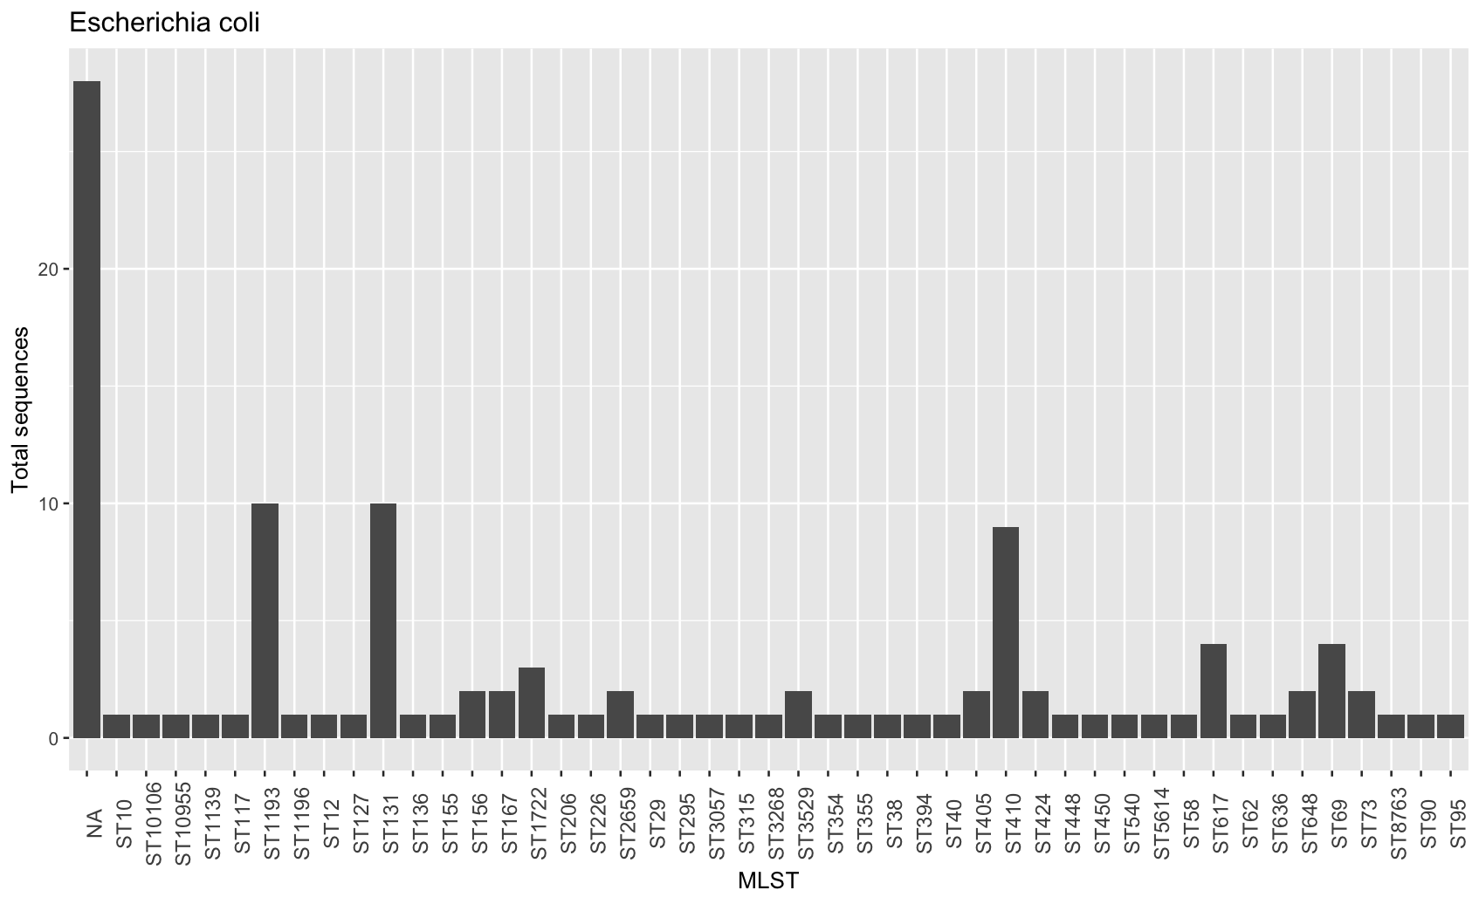
Sequencing results (4/4)

Slide 12
Key Points
Total samples collected: 922
Escherichia coli: 322 (34.92%)
KPSC: 498 (54.01%)
Staphylococcus: 102 (11.06%)
Regions involved: Centre, Far North, Littoral, North, West, and South West
Total samples sequenced: 228
Most frequent STs :
Escherichia coli: ST1193, ST131, ST410
KPSC: ST110, ST140, ST39
Total samples shared on Terra: 203
Escherichia coli: 116 (57.14%)
KPSC: 87 (42.85%)

Slide 13
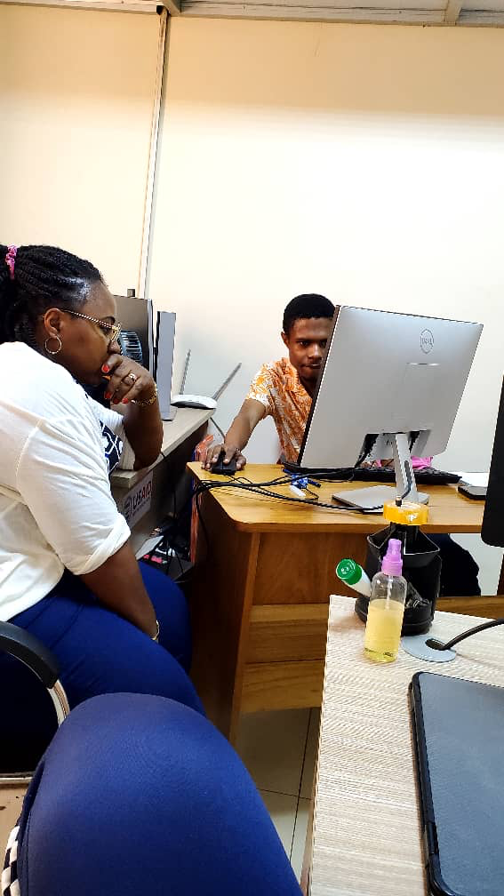

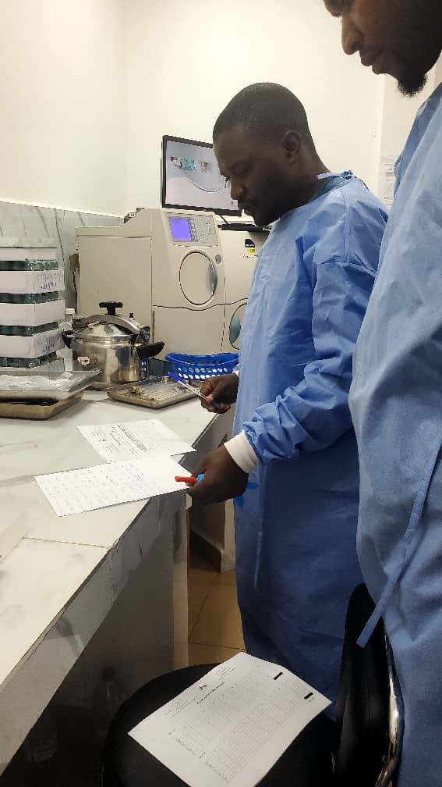
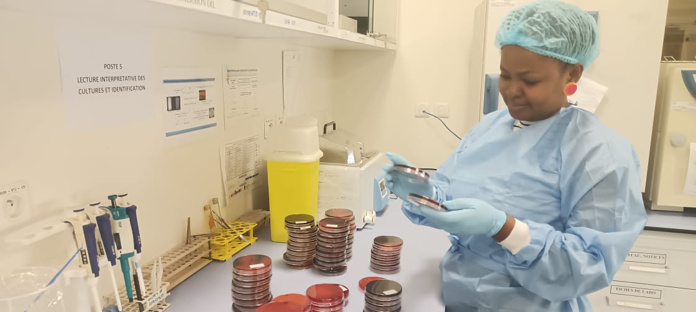
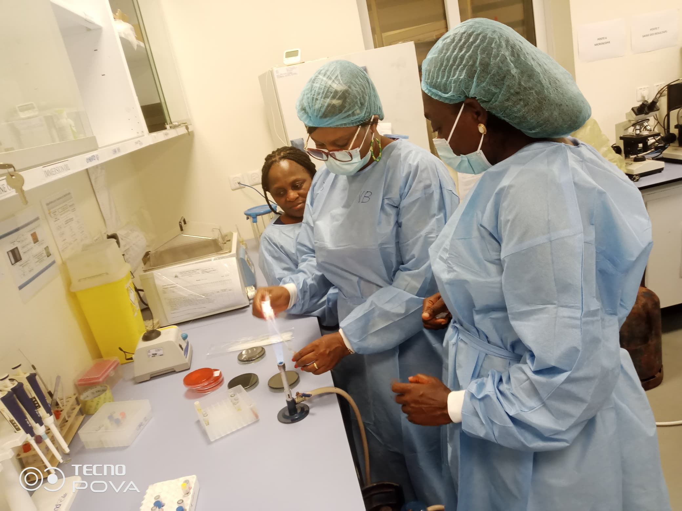
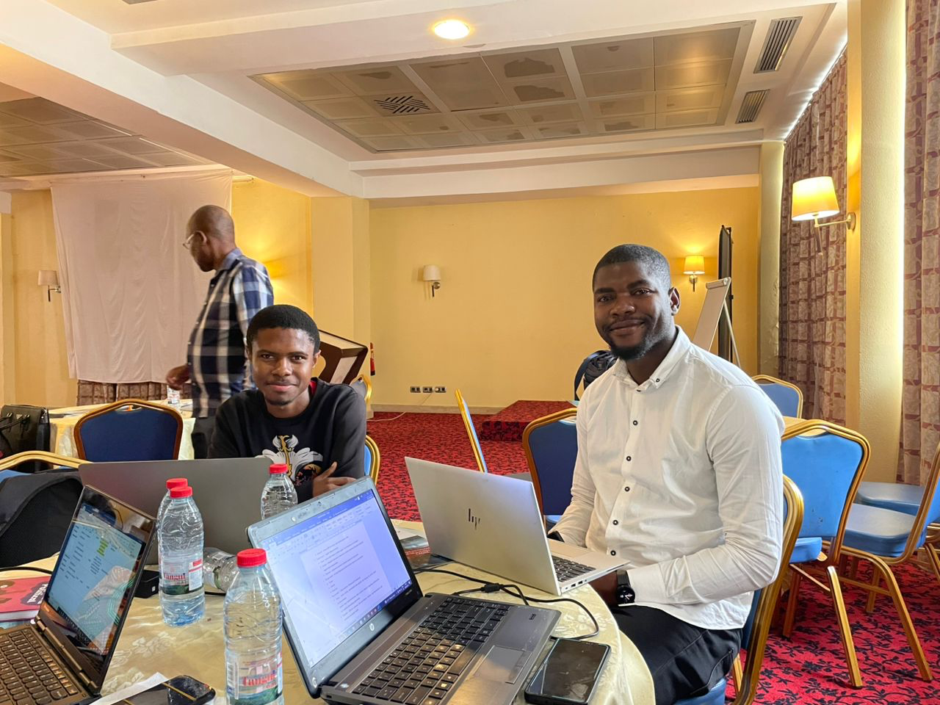
THANK YOU
MERCI

